Slide 1




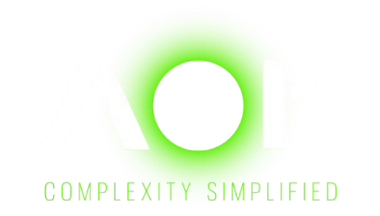



MITIGATE IDENTITY RISK
Implementing Zero Trust Architecture Cloud Native, On-Premise and Hybrid Cloud

Slide 2










Journey from “Castle & Moat” to Cloud to ZTA
“CASTLE & MOAT” TRADITIONAL SECURITY MODEL
CLOUD ADOPTION
Self-host virtualization environment / VMWare
Private cloud
Public cloud – AWS
Hybrid
NETWORK
Location-based security perimeter
DATA
Data at rest, data in transit, OWASP top 10
ENDPOINT
Server (Nessus vulnerability scanner), device / host agent (AV, DLP, EDR)
APPLICATION
Outlook DMARC
Is the new Attack surface or threat vector for “hybrid” Cloud environment Linear?
IDENTITY
IAM , PIM

Slide 3









Identity As New PerimeterCloud to ZTA
Identity as the New Perimeter
Set up the perimeter defense by installing Firewall along with IDS/IPS services
A couple Access paths i.e., Citrix or VPN to allow small number of sale and Operation support
A TRADITIONAL NETWORK
BASED SECURITY MODEL
Tenured workforce trust factor
Within this perimeter is considered trusted
WFH, Hybrid and global workforce
Perimeter extension – Cloud - to accommodate both workforce requirement and cost efficiency
TODAY’S LANDSCAPE HYBRID
BYOD & Software as a Service SaaS - Salesforce, ServiceNow, GitHub etc.
Weakest link Identity and Entitlement
Traditional network perimeter fades away
IDENTITY AS THE NEW PERIMETER
Authenticated identity - Human and Machine – Token & Claim

Slide 4
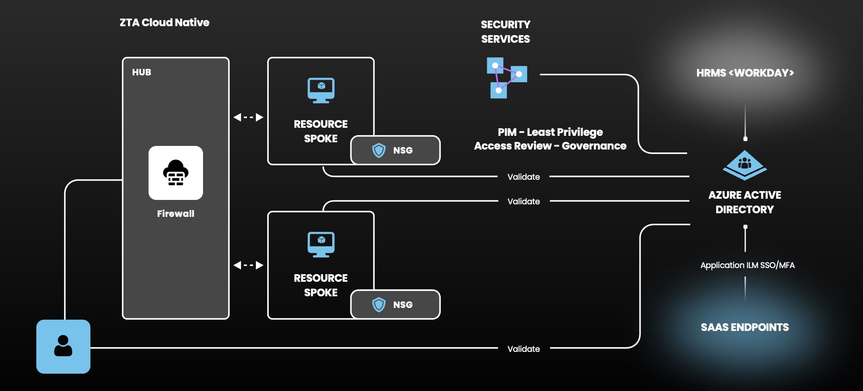
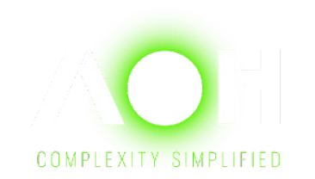
ZTA ARCHITECTURE – CLOUD NATIVE

Slide 5
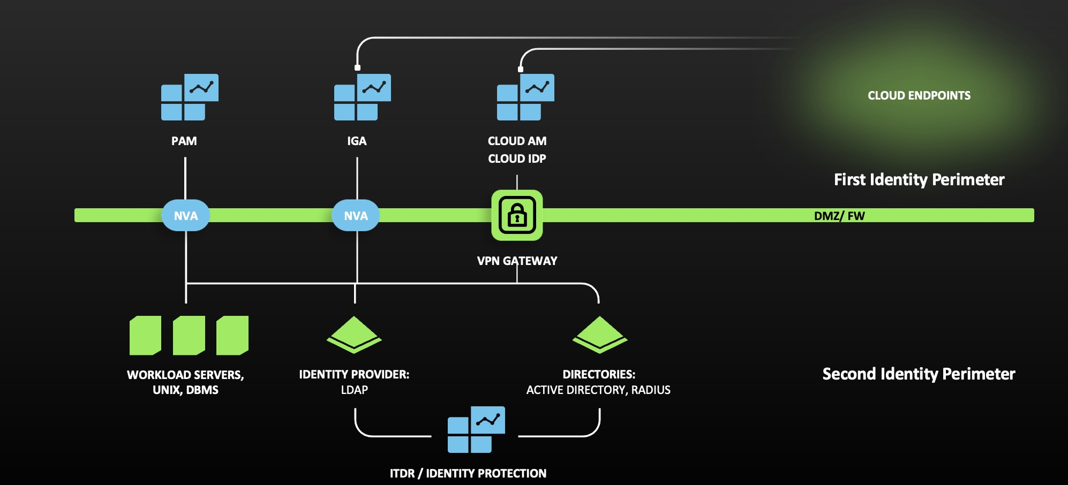
ZTA ARCHITECTURE DUAL IDENTITY PERIMETERS

Slide 6
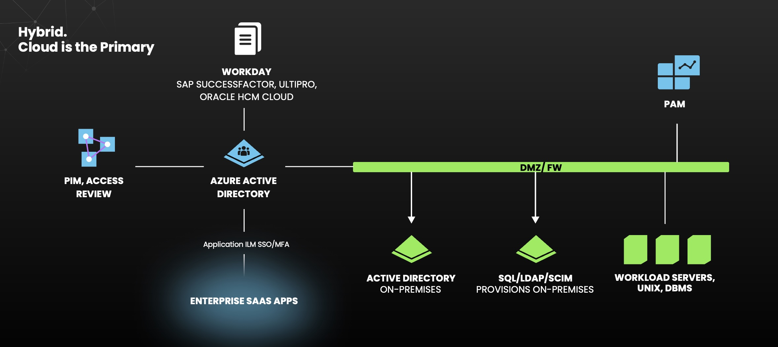
ZTA ARCHITECTURE – HYBRID CLOUD

Slide 7
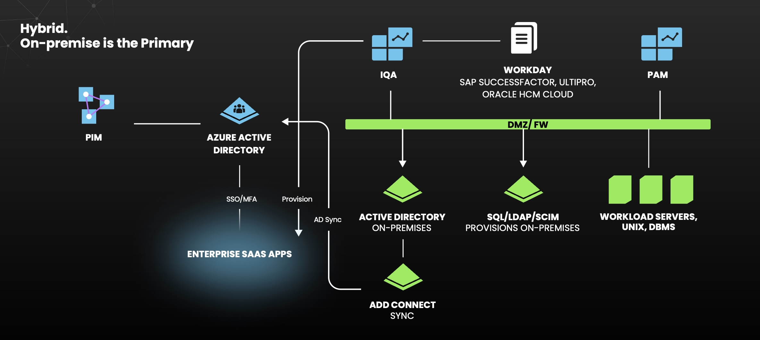
ZTA ARCHITECTURE – HYBRID CLOUD

